Slide 1
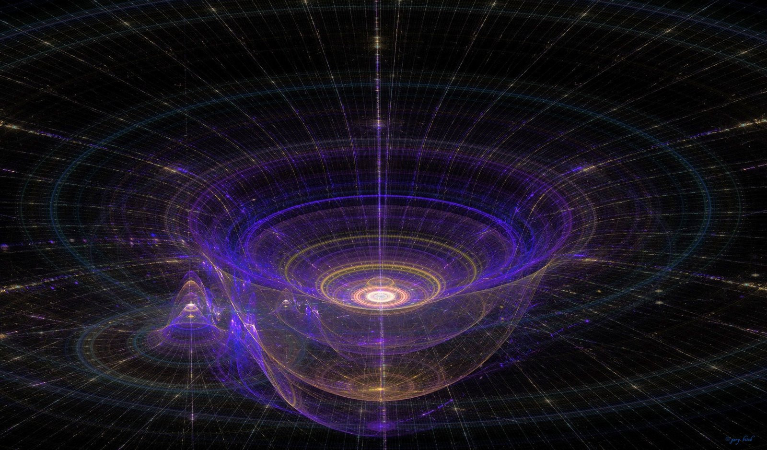
Gravity
This lesson will focus on the force of gravity
You will learn about how gravity affects objects both near and far from the surface of the Earth

Slide 2
Learning Goals
By the end of this lesson, you will be able to:
explain what causes gravity
explain the factors that affect the force of gravity
calculate the force of gravity on objects
compare the force of gravity on different objects

Slide 3
Success Criteria
Can I:
explain what causes gravity
explain how mass affects the force of gravity
explain how separation distance affects the force of gravity
calculate the force of gravity on objects of different mass

Slide 4
what causes gravity
Gravity was first studied by the ancient Greeks
Newton discovered Universal Gravitation, which tells you to calculate gravity
Einstein develop a theory about what causes gravity
Gravity is caused by the warping of space-time
Gravity is a result of mass. Mass warps space-time

Slide 5
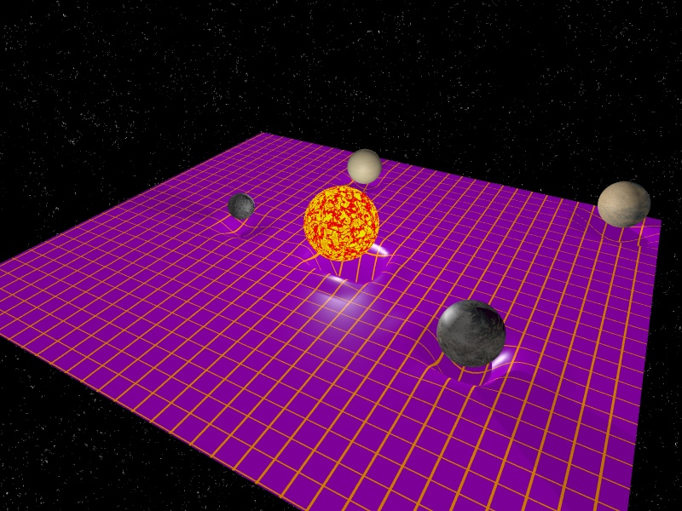

Slide 6
Gravity, like all forces require time to act
If the sun were to disappear at this exact moment, the Earth would remain in its orbit for about 8 min

Slide 7
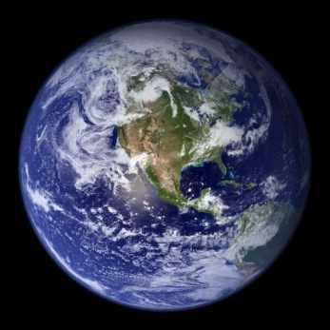
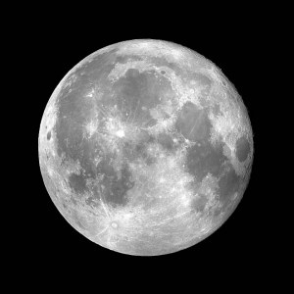
factors affecting gravity
Newton determined that there are two factors that
affect gravity:
Mass, m
Distance, r
Gravity is directly prop to the product of the masses

Slide 8
This means that as mass goes up, the force of gravity
goes up. As mass goes down, gravity goes down.
Gravity is inversely prop to the square of the
separation distance
This means that as distance increases, the force of
gravity decreases. As distance decreases, gravity
increases

Slide 9
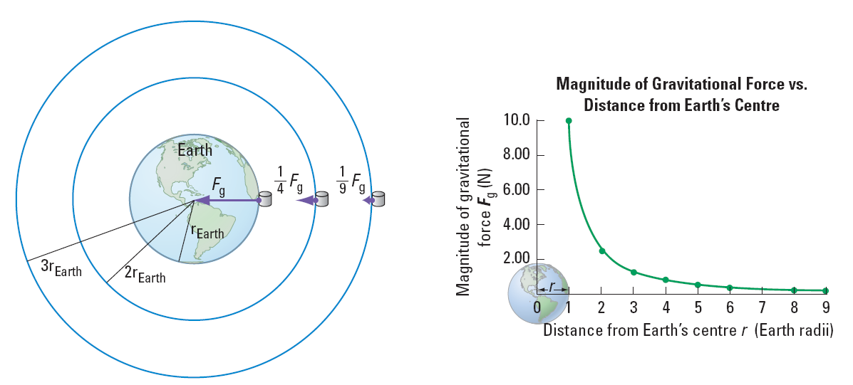

Slide 10
calculating the force of gravity
Newton used his two relationships to develop
Universal Gravitation:
G = 6.67 x 10⁻¹¹ N∙m²/kg²
Newton never determined the value of G, its value
was discovered by Henry Cavendish after Newton
died

Slide 11
Around all objects with mass is a gravitational field
If you know the gravitational field strength, you can
quickly determine the force of gravity by using the
following eqn
g is the grav field strength
At the surface of the Earth g = 9.8 N/kg
F_{g} is called the weight of the object

Slide 12
PRACTICE Problem
1. What is the force of gravitational attraction between a sumo wrestler of mass 200. kg and a gymnast of mass 50.0 kg that are 1.0 m apart?
67. N
6.7 N
.67 N
.067 N
6.7 x 10⁻⁷ N

Slide 13
PRACTICE Problem
2. Who developed Universal Gravitation?
Newton
Galileo
Einstein
Bohr
Lamonica

Slide 14
PRACTICE Problem
3. Who determined that gravity is caused by the warping of space-time?
Newton
Galileo
Einstein
Bohr
Lamonica

Slide 15
comparing the force of gravity
remember F_{G} α m_{A}m_{B} and F_{G} α 1/r²

Slide 16
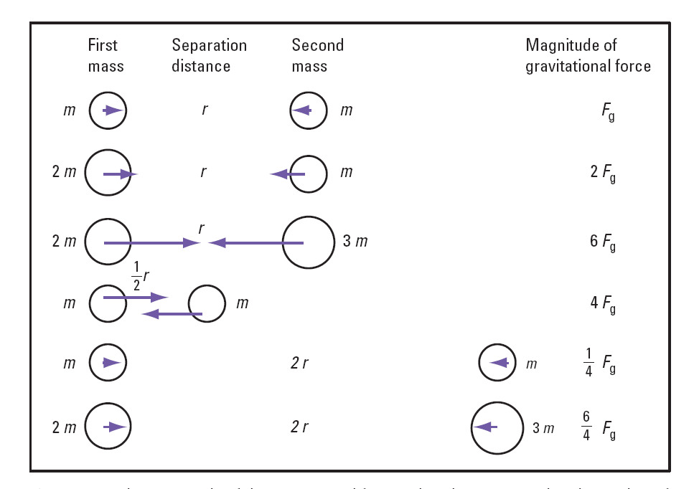

Slide 17
PRACTICE Problem
4. The force of gravity between the Earth and a space probe is 500.0 N. If the probe moves to three times its original distance, what is the new force of gravity?
1500. N
4500. N
166.7 N
55.56 N
Can’t be determined without knowing the distance

Slide 18
PRACTICE Problem
5. The force of gravity between the Earth and a space probe is 500.0 N. If the probe moves to one-third times its original distance, what is the new force of gravity?
1500. N
4500. N
166.7 N
55.56 N
Can’t be determined without knowing the distance

Slide 19
PRACTICE Problem
6. The force of gravity between the Earth and a space probe is 500.0 N. If the probe doubles in mass, what is the new force of gravity?
1000. N
4000. N
250.0 N
125.0 N
Can’t be determined without knowing the mass

Slide 20
PRACTICE Problem
7. If the probe doubles in mass and the distance triples, what is the new force of gravity?
1000. N
666.6 N
333.3 N
111.1 N
0 N

Slide 21
PRACTICE Problem
8. What is the force of gravity on a 2.0 kg melon resting on the surface of the Earth?
20. N
19.6 N
9.8 N
4.9 N
Can’t be determined without m_{E} and r_{E}

Slide 22
HOMEWORK
Read Section 4.1
Review Tutorial 1
Questions 1 – 4 pg 166

